Slide 1

Hop or not to hope.

Slide 2
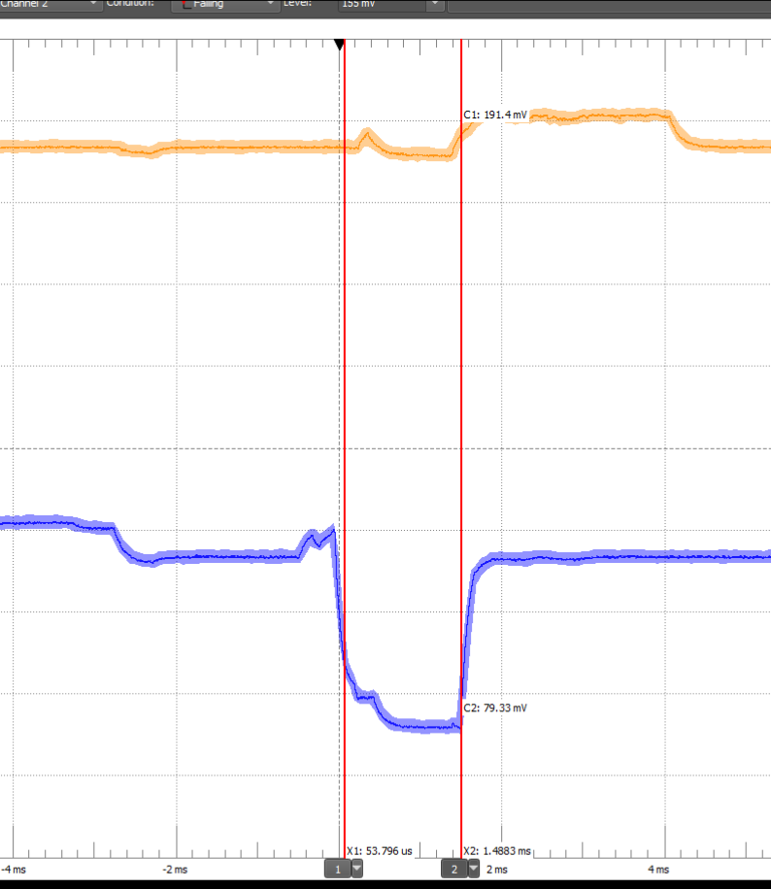
Power
Sending with -25DB
Receiving

Slide 3
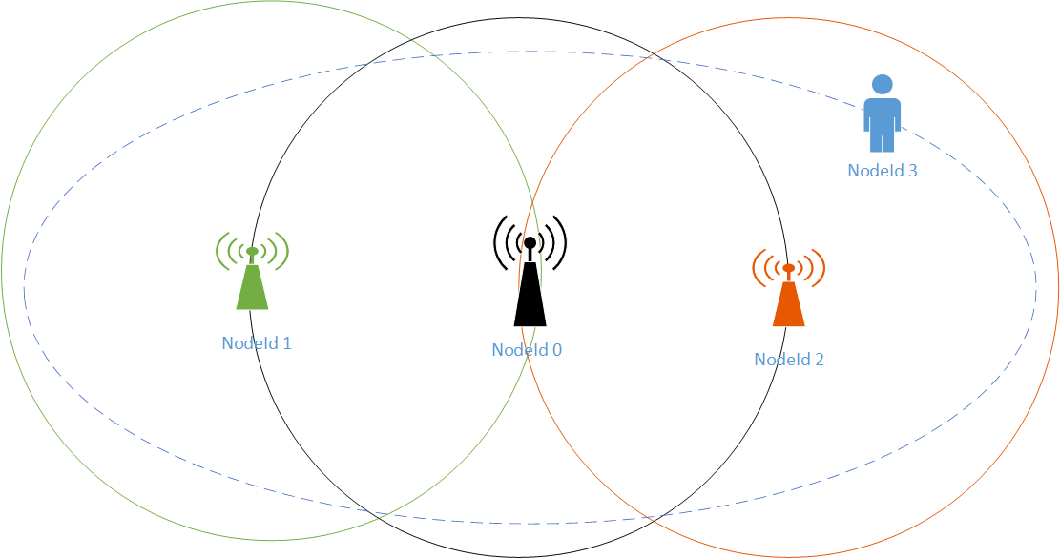
Scenario
Get runners pules
Talk directly when possible
Use relays to extent track
Simple relay
RSSI relay

